Slide 1
Elective Course Robotics ELC4047
Prof Ahmed Ali Abouelsoud
2023/24

Slide 2
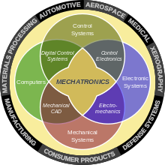
This course studies robotics in terms of classification, types, motion description and planning
Robotics is part of mechatronics which is a merge between mechanics , control electronics, and computer

Slide 3
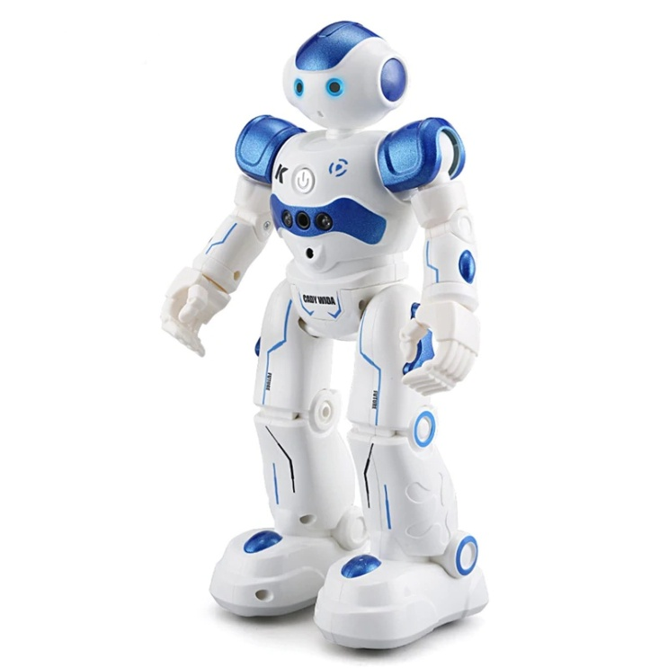
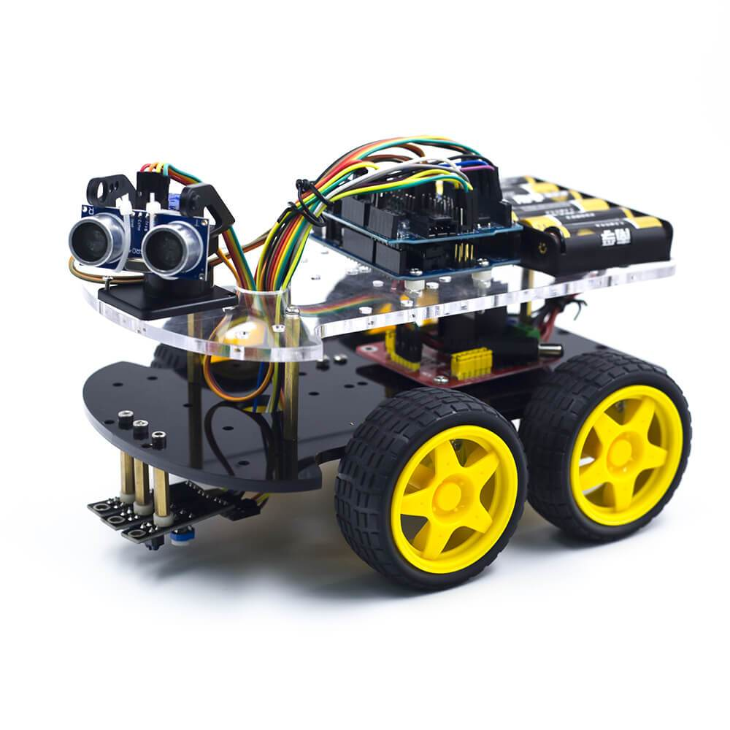
The type of robot is determined by the application
Vehicle Homidoid

Slide 4
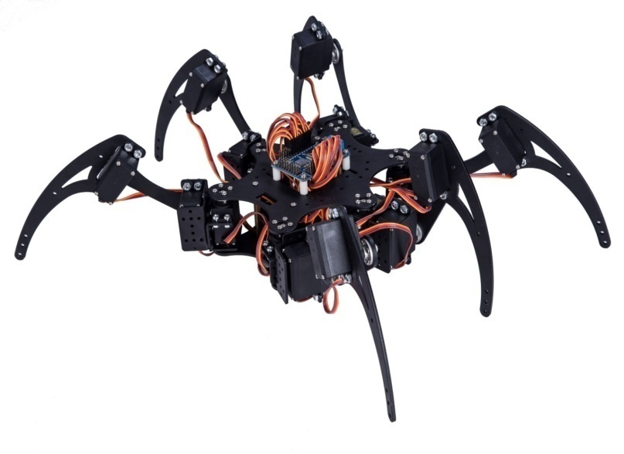
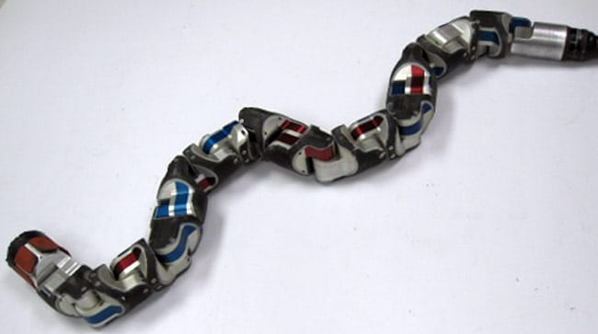
Snake Spider

Slide 5
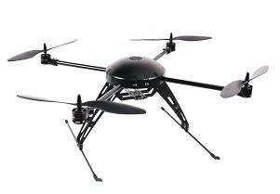
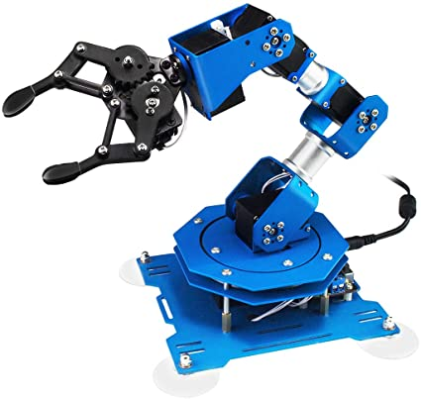
Quad rotor
Serial arm

Slide 6
The course concentrates on serial robot arm (manipulator) and describes its motion, control and trajectory planning.
Robot motion is studied through kinematics (position, orientation, velocity, acceleration) and dynamics (force and torque).

Slide 7
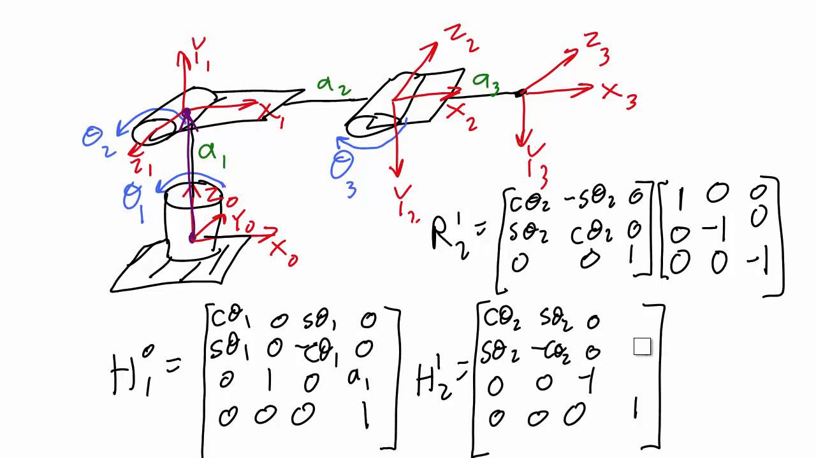
Robot arm is essentially rigid multi-bode system of links joined by rotary or prismatic joints and actuated by electric motors. To systematize the method of determining the position, orientation, etc... we use matrices and in particular homogenous transformation.

Slide 8
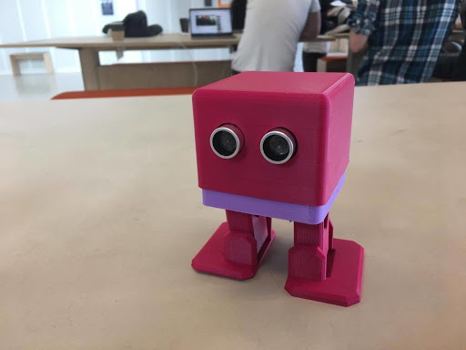
Thank You

