Slide 1
Programmable Logic Controllers (PLCs)
An Introduction

Slide 2

What is a PLC?
A PLC is a microprocessor based general-purpose controller for industrial applications
Advantages of using PLCs in industrial applications:
- noise immune hardware
- modular structure allowing addition/replacement of units
- standard input and output units with hardware interfaces for direct connection of input devices (transducers) and output devices (actuators).
- ease of programming and reprogramming on site.

Slide 3
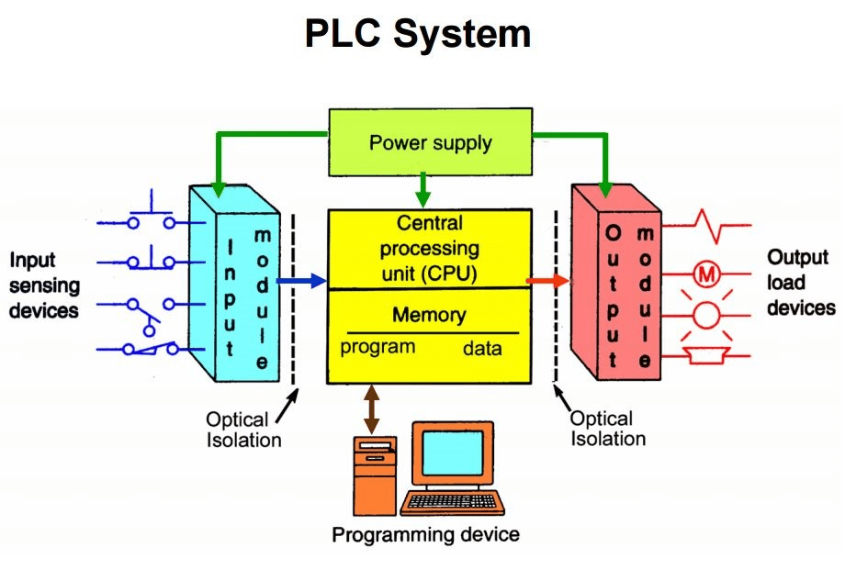
Hardware Structure of PLCs

Slide 4
The PLC hardware consists of the following functional units:
Central processing unit (CPU): It controls and supervises all operations of the PLC. An internal communication bus connects the CPU with the memory and input/output units.
Memory unit: for storage of program (program memory) and storage of data and outcomes of internal functions (work memory).
Input and output units: The input and output units form the interface between the internal hardware of the PLC and the outside input and devices monitored by the PLC and output devices controlled by the PLC. Input/output units operate at specific voltage levels (AC/DC) selected according to the intended input/output devices of the process transducers/actuators. Input/output units provide the necessary isolation and signal conditioning required by the input/output devices.
Each input channel has a specific status bit with a unique address to store 1 or 0 depending on the state of the input device ON or OFF in case of digital inputs.
Each output channel has a specific status bit with a unique address to store 1 or 0 depending on the required control of the output device to be switched ON or OFF in case of digital outputs.
Programming unit: It is used to enter the PLC program. All PLCs may have a usual PC as a programming unit with the necessary programming environment running as an application program

Slide 5
The programming unit is connected to the PLC using a special cable. After programming and testing of the program the programming unit is disconnected from the PLC.
PLC Selection
PLCs come in modular structure in which the main unit determines the CPU speed and program/work memory size depending on the required application. Input and output units determine the number of input and output devices to be monitored and controlled by the PLC. They are chosen taking into consideration the levels of voltage imposed by the process transducers and actuators.
PLC Operation
PLCs operate in real-time in which a program is executed from beginning to end using current inputs status bits. The input status bits 1 or 0 are determined by the states of the input devices ON or OFF. Based on the logic described by the program output status bits may have 1 or 0. This will determine which output device to be switched ON or OFF as required. PLC programs are executed in continuous cycles. A program cycle begins by updating the 1s and 0s in the input status bits (input image) depending on whether the connected input device is ON or OFF. Afterwards the program is executed from first instruction to the last one. Due to the logic of the program output status bits may be changed from 1s to 0s or vice versa. After program execution output status bits (output image) are copied to the connected output devices. If an output status bit is 1, the connected output device is switched ON. Whereas if it is 0 the connected output device is switched OFF.

Slide 6
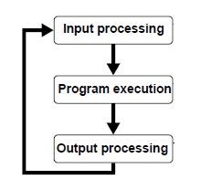
PLC Program Scan Cycle

Slide 7
PLC Programming
Programming instructions and addressing used to program a PLC may differ from one manufacture to another. In this course we shall adopt a Mitsubishi-FX series PLC.
Addressing of input status bits consists of a symbol X followed by an octal number. Addressing of output status bits consists of a symbol Y followed by an octal number.
In order to construct logical functions in programs we use two logical single bit operation which are defined by the following truth tables
X1 examine-ON X2 examine-OFF
0 F 0 T
1 T 1 F
Boolean expressions describing logical functions are used as usual e.g.
Y1 ≡ X1+ X2 In this expression an output status bit Y1 is determined based on the outcome of ORing two input status bits X1, X2
Y2 ≡ X3 . X4 An output Y2 is based on the outcome of ANDing two inputs X3, X4
Y3 ≡ (X1 + X2). X3 an output Y3 is based on ORing X1, X2 then ANDed with X3.

